Slide 1

AI vs Non-AI Art Image Classification
ECGR - 4105 Team Members: Cole Fredrick, Joelle Bailey, Noah Telfer

Slide 2
Agenda
Overview
Building the DataSet
GANGogh
Stable Diffusion
RoboFlow
Modeling
What is Resnet
Model Specifics
ResNet18 Results
ResNe34 Results
Test Case
Questions

Slide 3
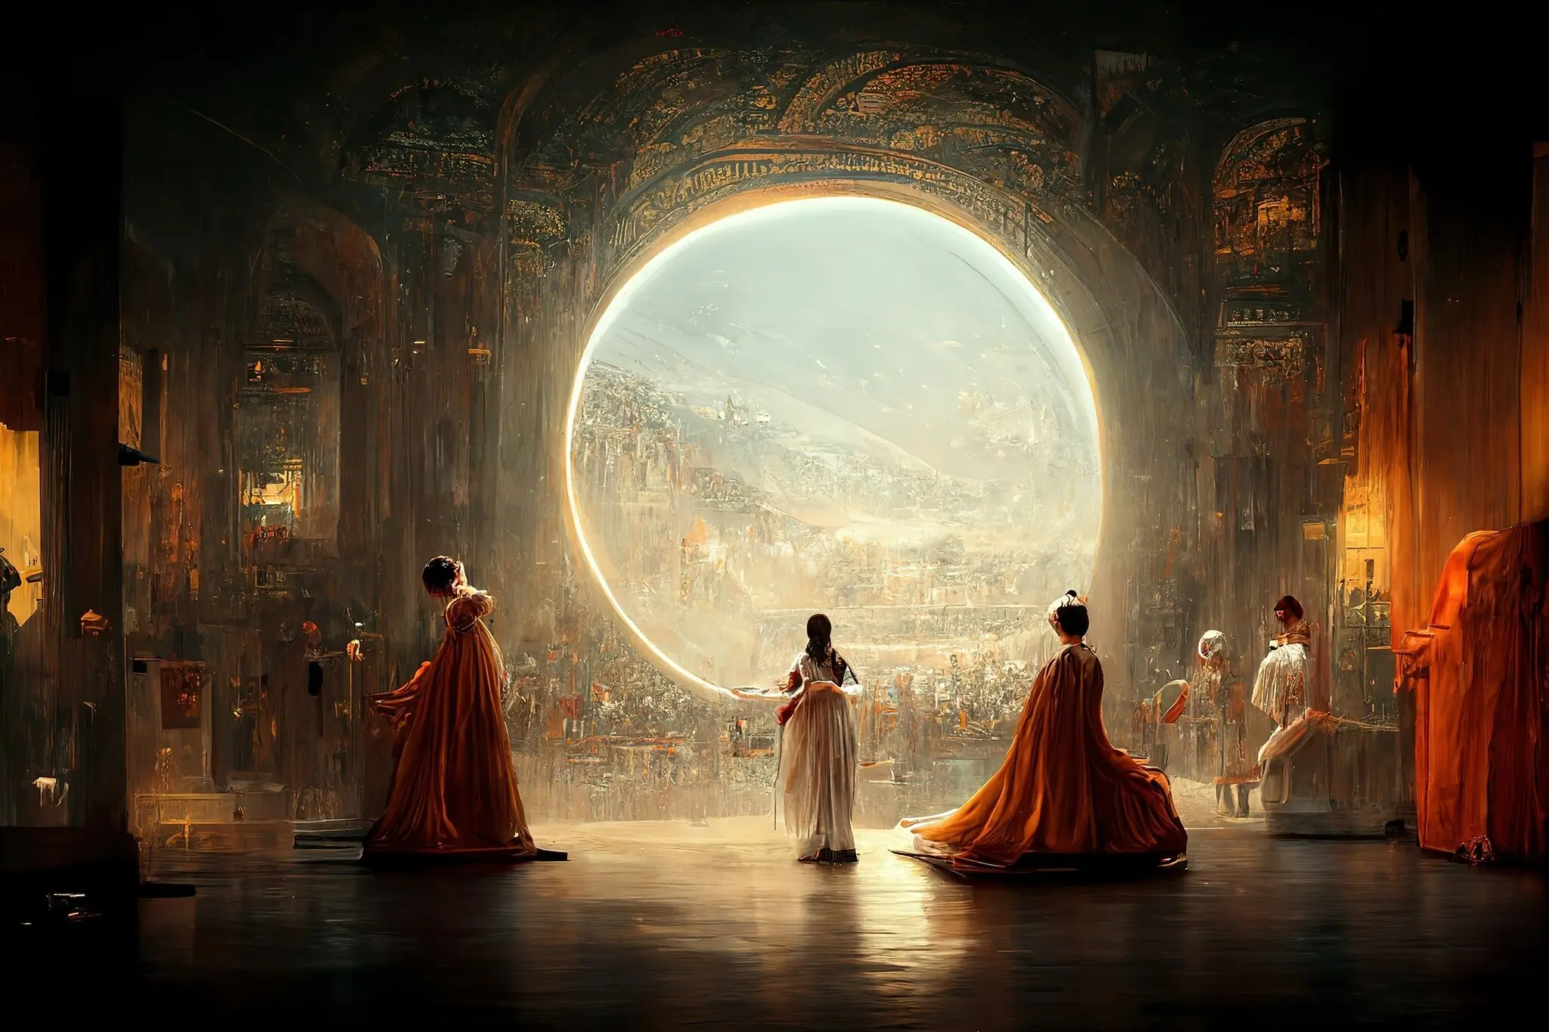
Théâtre D’opéra Spatial by Jason Allen via Midjourney

Slide 4
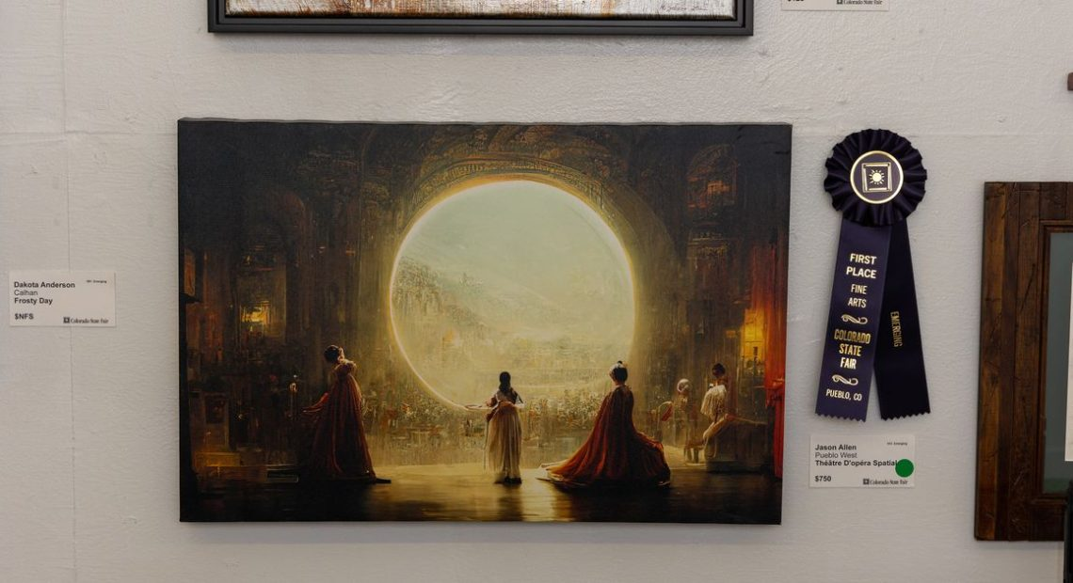
Problem
As AI art quality increases and it becomes easier to generate distinguishing the difference between a human and AI becomes more of necessity
Commissioned artists, buyers and online art communities are the main groups being affected by this mass influx of AI art
Example: The image to the right entitled ‘Théâtre D’opéra Spatial’ came in first place in a human art competition in Colorado

Slide 5
Solution
To design and develop a classification dataset utilizing two classes of pictures NON-AI Vs. AI.
Utilize and perform a comparative analysis of two architectures of ResNet models that would learn to identify the nuances between the two classes of images and ultimately be able to tell the illusion versus the real.

Slide 6
Dataset Generation:
GANGogh & Stable Diffusion

Slide 7
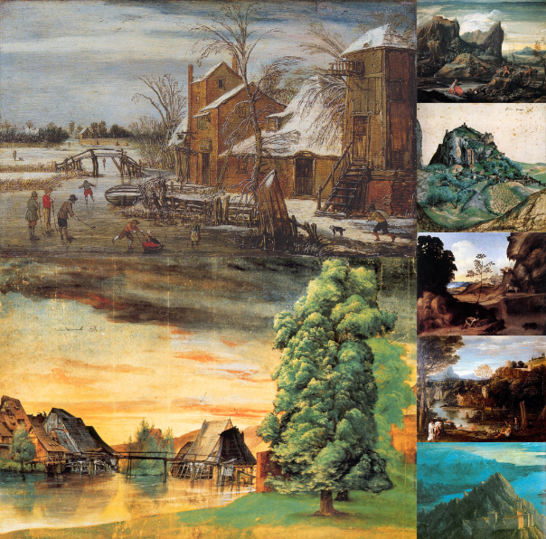
GANGogh & Test Data
A selection of a 34.7 Gb compressed file of hand made classical images of a variety of categories originally sourced from Wikiart.org was used for the Non-AI section of our dataset
GANGogh is a well-known classical image generation GAN model, furthering the test data’s applicability to our project scope
Notes:
Thank you Noah! So to start us off with our Dataset setup, we’ll begin by talking about GANGogh. We gathered a large variety of classical landscape images from the Gangogh test set in order to define what our NON-AI Class was as an image. The set itself was comprised of tens of thousands of images separated into 13 categories with varying resolutions. The category “Landscape” is what we decided to pull from. And to summarize briefly, GANGogh on its own is known as a derivative of a a GAN Model whose sole purpose is to generate classical artworks. Next up we will talk about stable diffusion.

Slide 8
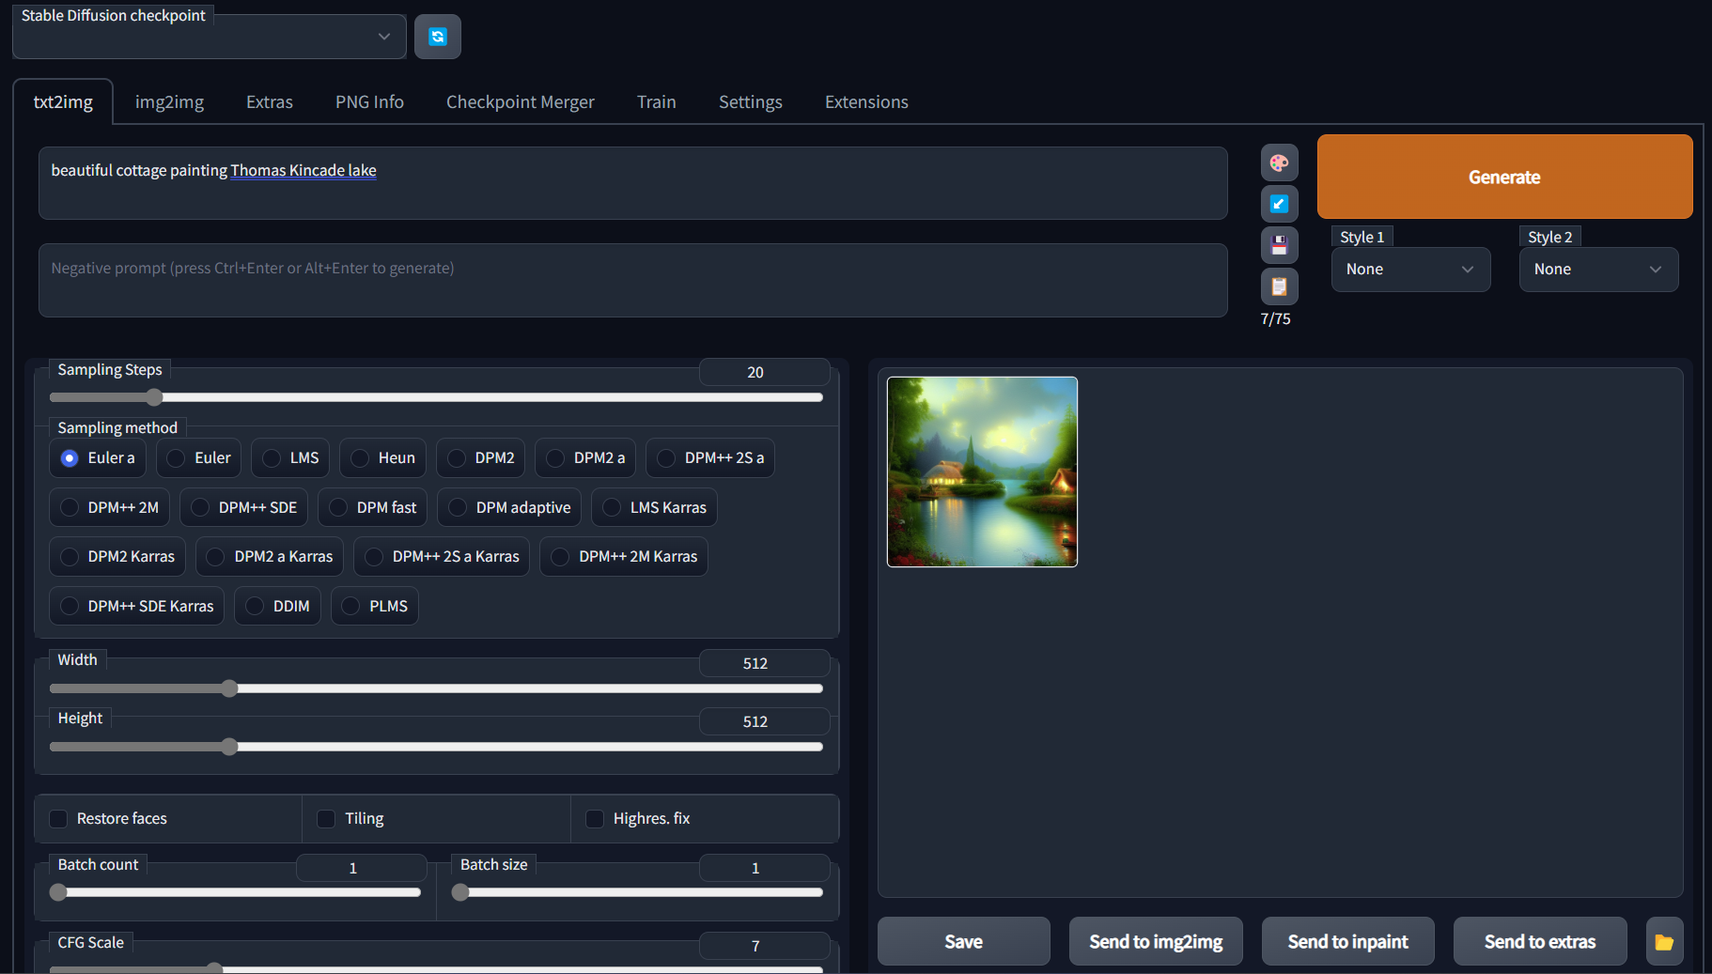
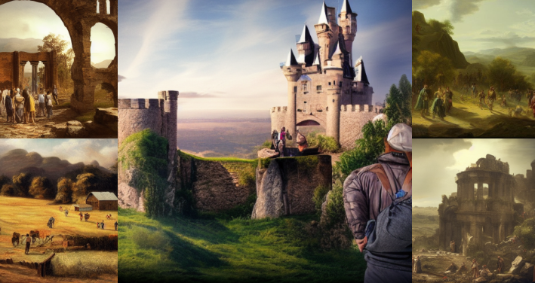
Stable Diffusion by StabilityAI - sourced from Hugging Face
Stable Diffusion, an open source AI image generation software, was used to create the 945 images created for this project
Used text-to-image functionality with preselected prompts
Stats
Euler A
Sample Steps: 55
Height and Width: 512x512 px
Prompt: landscape, people, epic scene, <location:farmhouse, manor, etc.>
Notes:
Stable diffusion is our sole source of definition for our AI image class. In short, this software provided us the ability to create large batches of AI images given a prompt, a degree of sample steps, a resolution size and a sampler type.
For our setup stats: Our Sampler type was Euler (A) Default
Sample Steps: 55, which was what gave us the best quality of our standards with efficient processing time.
Image resolution: 512x512 (Default)
And our general prompt relied around changing the final keyword, “location”. With the rest of the prompt consisting of words as “landscape, people, and epic scene”
Now to talk about our dataset manager, roboflow.

Slide 9

RoboFlow
RoboFlow is image operations dataset builder and processor.
Steps:
Upload
Annotate
Preprocessing
Each image was resized to 512x512px
Auto-Orient
Export
Notes:
Roboflow is honestly what made the majority of this projects’ objectives way more feasible.
Roboflow in summary and as described in the slide shown here – is an image operations dataset builder and processor. It has a lot of onset utilities especially in the realms of image classification that allows a user to organize, annotate, and import a dataset into your notebook within relatively short periods of time.
We first uploaded all of our images, and then annotated each of them to assign either a class of AI or NON AI.
The application allowed us to split our dataset 70/20/10, respective of training, validation, and test.
Finally, we processed each image with a 512x512 resize and auto orientation.
Now to move it over to Joelle for Modeling.

Slide 10
Modeling:
ResNet

Slide 11
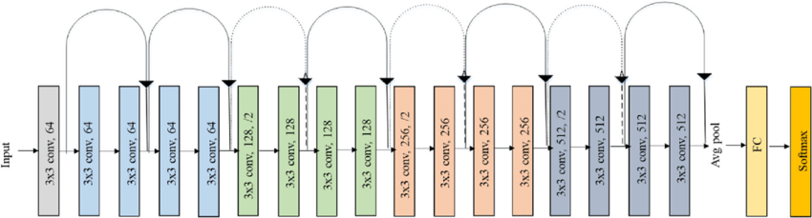
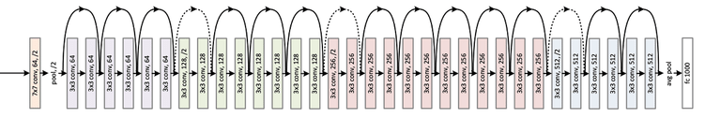
What is ResNet
ResNet is a convolutional neural network that utilizes residual connections, which allows the network to learn more effectively by enabling the flow of information from earlier layers to enter later layers in the network.
ResNet18
Architecture
ResNet34
Architecture

Slide 12
Model Specifics
General Training Setup
Learning Rate | 0.001
Transformations | Normalized Data
Batch | 64
Optimizer | Stochastic Gradient Descent
Loss Function | Cross Entropy
Number of Epochs | 10
Momentum | 0.9
ResNet Models to be used:
ResNet18
ResNet34
Pre-Trained vs Untrained
ResNet can be imported with Pre-Trained parameters trained with the ImageNet Model

Slide 13
Results

Slide 14
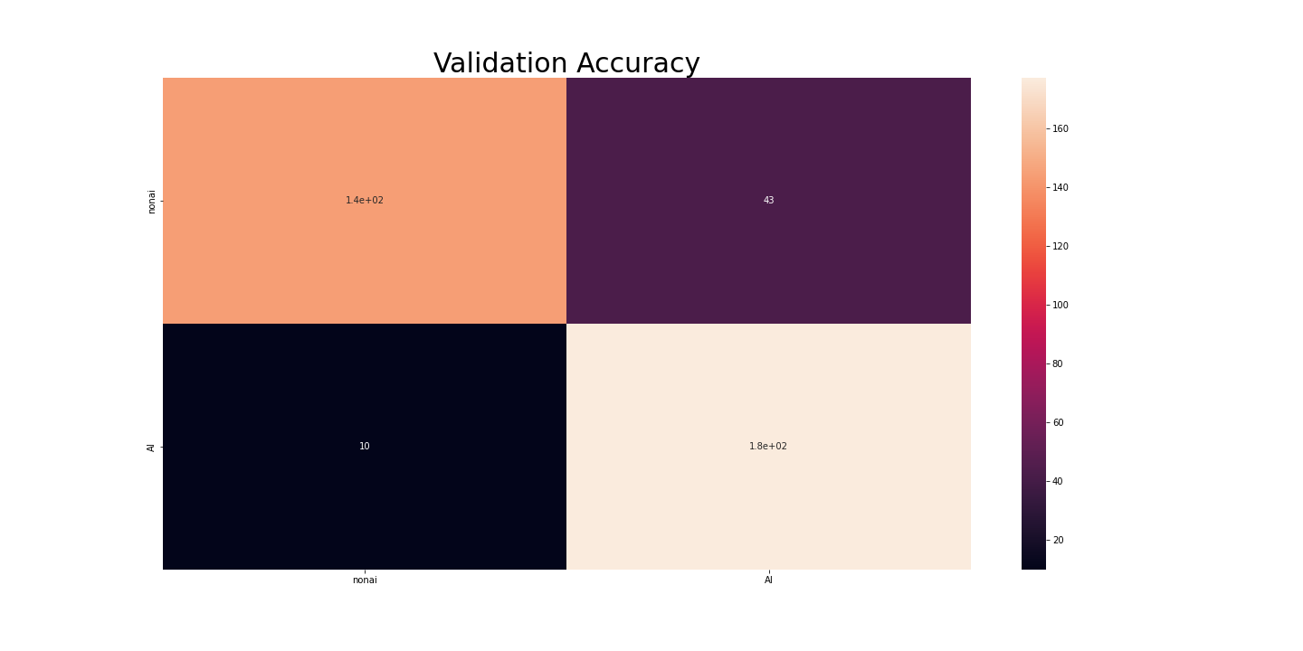
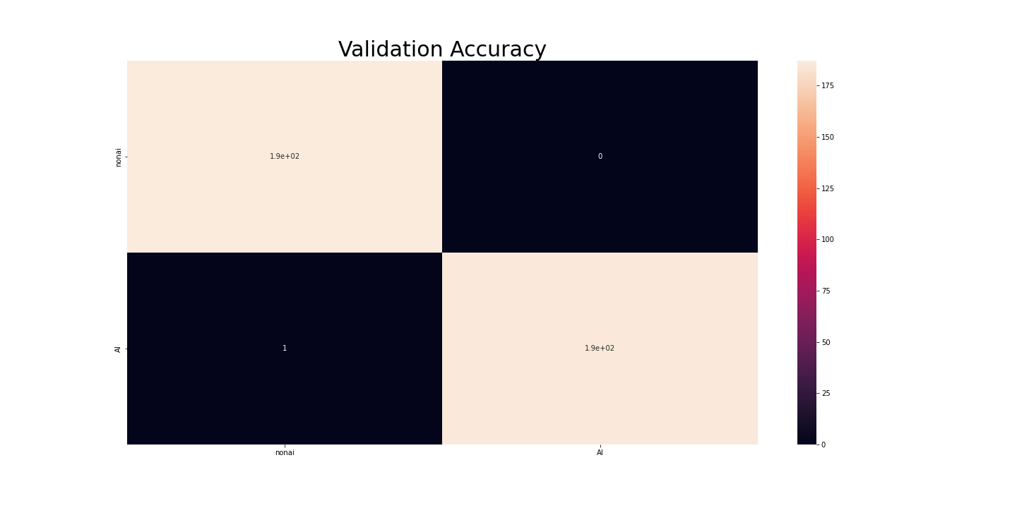
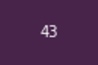
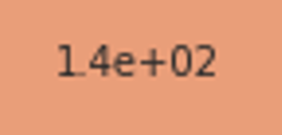
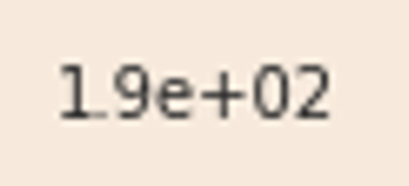
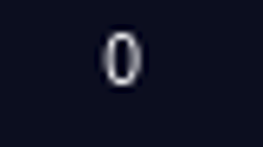
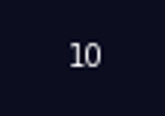
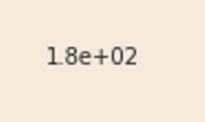
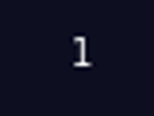
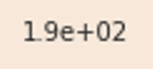
ResNet18 Results
ResNet18 (Untrained) Results
Training Time | 351.54s
Training Accuracy | 92.33%
Validation Accuracy | 74.86%
ResNet18 (Pretrained) Results
Training Time | 292.23s
Training Accuracy | 99.84%
Validation Accuracy | 99.73%

Slide 15
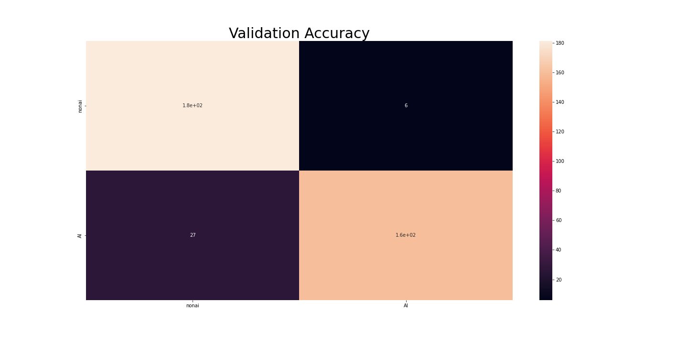
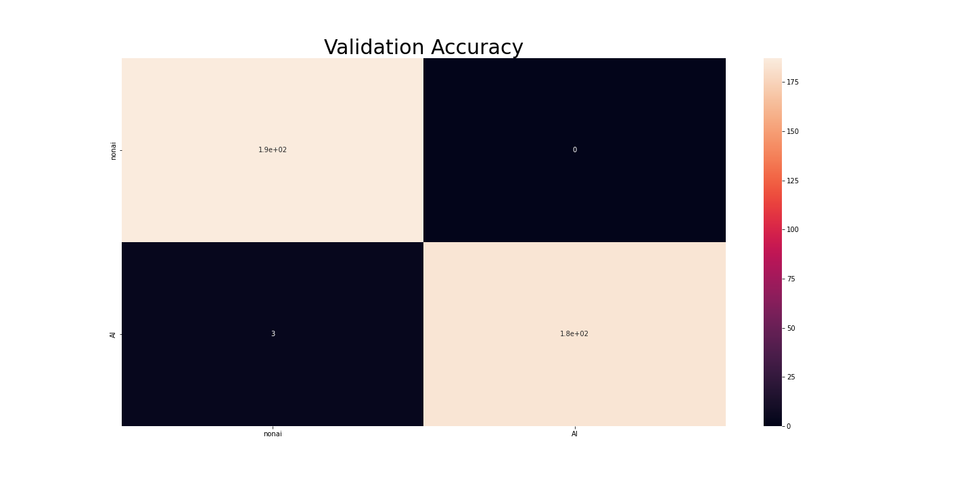
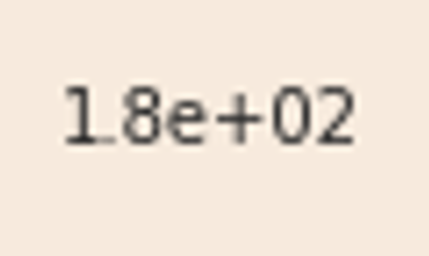
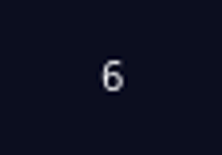
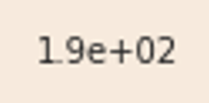
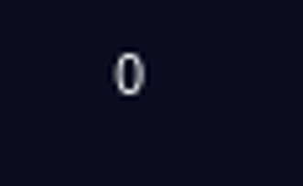
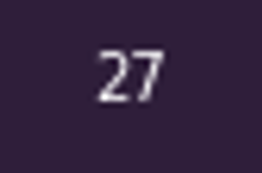
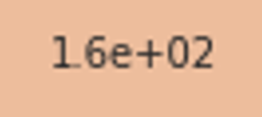
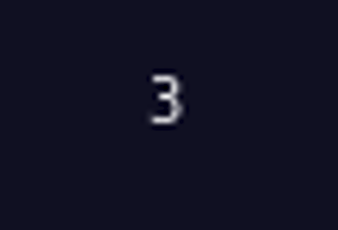
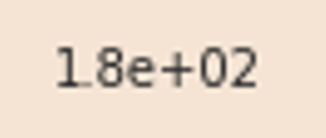
ResNet34 Results
ResNet34 (Untrained) Results
Training Time | 373.0389s
Training Accuracy | 92.87%
Validation Accuracy | 91.18%
ResNet34 (Pretrained) Results
Training Time | 102.2524s
Training Accuracy | 100.00%
Validation Accuracy | 99.20%

Slide 16
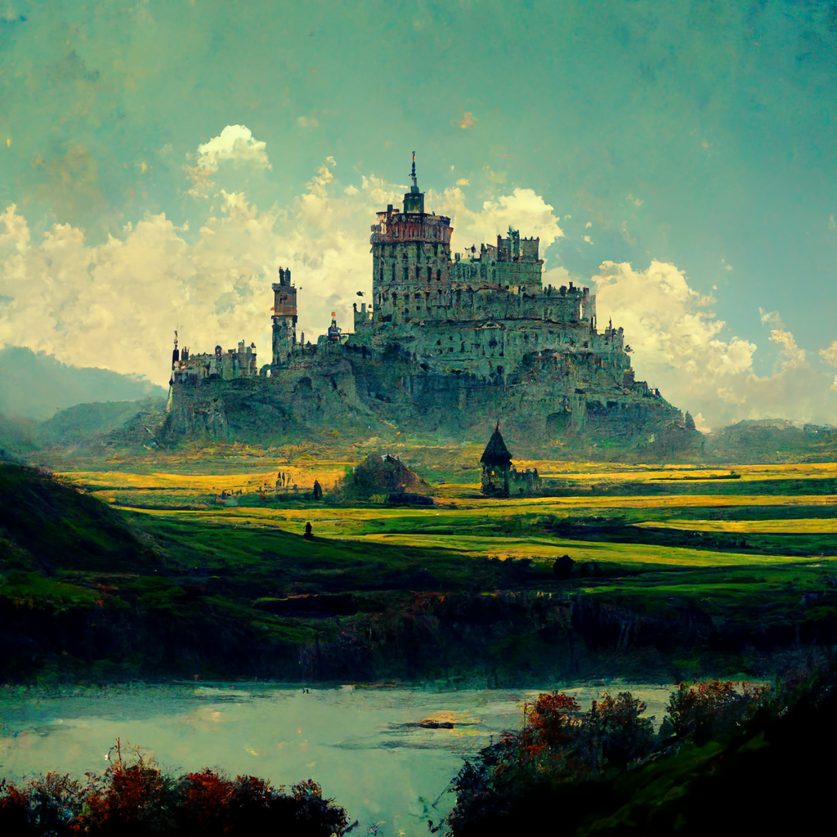
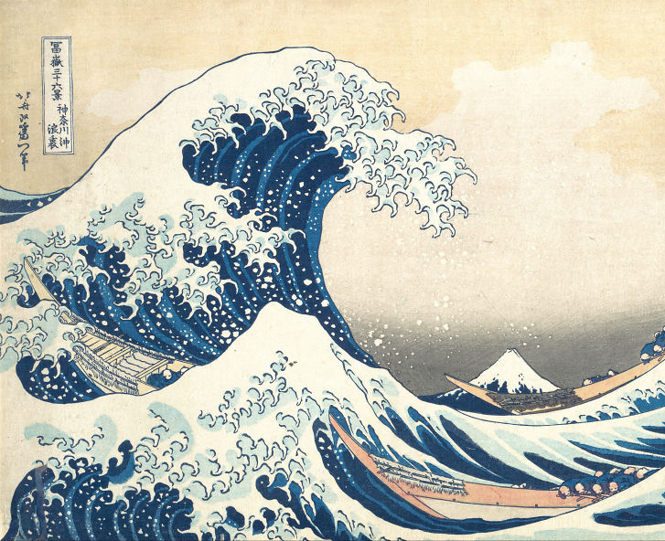
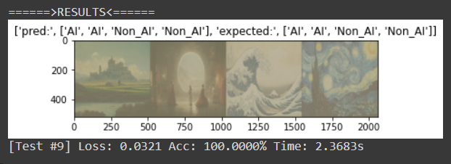


Slide 17
Questions?

